Slide 1

Computer Systems
Oct 2023

Slide 2
What will I learn today 9/3/2022
Define
Define a computer system
Draw
Draw Von Neumann Architecture of a computer
Describe
Describe each component that constitute Von Neumann Architecture

Slide 3
What is a computer system?
Computer systems are a combination of both hardware and software working together to achieve a common goal.
A computer system can be described as one that involves interaction between:
Hardware (physical computer, screen, mouse, keyboard etc)
Software (the computer programs e.g. operating system, Microsoft Word, Google Chrome..)
Data
The human user

Slide 4
How Computers Work Introduction
How Computers Work: What Makes a Computer, a Computer? - YouTube

Slide 5
Computer Architecture
Computer Architecture is a specification of how a computer’s parts are physically and logically connected.
Computer Architecture is similar to architecture of a house, there are many different designs
Many of today’s computers have a common high-level architecture, that is known as Von Neumann Architecture

Slide 6
Von Neumann Architecture Introduction
Very early computers could not store programs and, hence, in 1945, John von Neumann developed an idea of a computer that could store programs, which is also known as von Neumann architecture.
He suggested that data and programs could be stored in memory and that the data would be transferred between the memory and the processor during processing.
The computer architecture he described in 1945 is still relevant today

Slide 7
CPU and Von Nuemann Architecture
https://www.youtube.com/watch?v=SbqXqQ-2ixs

Slide 8
von Neumann Architecture
Von Neumann architecture contains four main components:
A Central Processing Unit (CPU) which executes instructions
Memory which stores both DATA to be operated on, the INSTRUCTIONS (programs) that operate on the data, and the results.
A Bus connecting the CPU and the memory. This is represented by the pair of arrows (from memory to CPU and back)
Input and Output devices that allow data to come into the computer and results to be sent out.
All the components work together to allow processing of the data and system control.

Slide 9
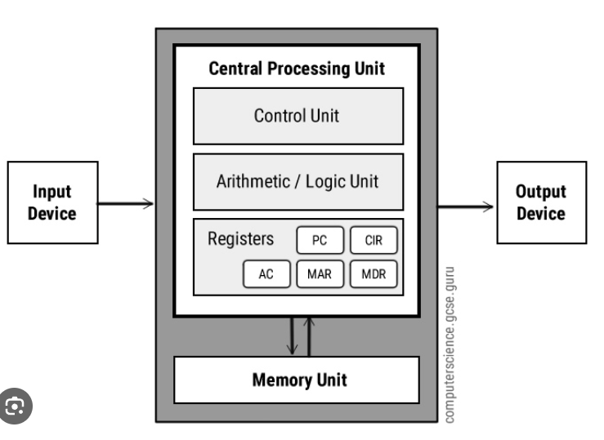
Von Nuemann Architecture

Slide 10
Von Neumann Architecture - CPU
The Control unit (CU) directs/controls the operation of the CPU.
The control unit is responsible for controlling the memory, processor and input-output devices.
It contains the CIR (Current Instruction Register) and PC (Program Counter) registers.
The CIR (register) contains the current instruction carried out by the processor.
The PC contains the location of the next instruction to be executed.
The control unit reads the instructions from the memory, decodes it and sends control signals to the memory and input-output devices.

Slide 11
Von Neumann Architecture - CPU
Arithmetic logic unit (ALU)
The ALU has two main functions:
The ALU is responsible for arithmetic functions such as addition, subtraction, multiplication, etc. and logic operations such as AND, OR, NOT, etc.
The accumulator register (ACC) stores the results of arithmetic and logical operations performed by a processor.

Slide 12
Von Neumann Architecture - CPU
Registers
Register memory is very expensive and the fastest. Registers have a small capacity compared to other types of memory e.g. RAM or ROM
Different processors have different numbers of registers for different purposes. Most have some, or all, of the following:
program counter (PC)
memory address register (MAR)
memory data register (MDR)
current instruction register (CIR)
accumulator (ACC)

Slide 13
Von Neumann Architecture - CPU
Registers
Registers -> The Program Counter
Contains the memory location of the next instruction to be executed
CIR (Current Instruction Register) the current instruction being decoded
Accumulator (ACC) - the results of calculations

Slide 14
Von Neumann Architecture - CPU
Registers -> Memory Data Registers
Hold data temporarily. This data is operated on by the CPU. This data originally came from memory across the bus and the results will typically be returned to memory.
Registers -> Memory Address Registers
Store memory addresses. This is a value that indicates a specific location in memory. This could be the location in memory of data to be operated on, or results to be sent to memory over the bus.

Slide 15
Von Nuemann Architure – Input & Output Devices
An input device, like a keyboard or mouse, converts the signals sent by humans to a form that can be understood by the computer.
Output devices such as printers, monitors, etc. convert the information from the computer into a form that is understandable by humans.

Slide 16
Von Neumann Architecture – Fetch –Decode- Execute Cycle
To carry out the instructions, the processor fetches the data and instructions from the memory and stores it in suitable registers.
These instructions are decoded and then executed.

Slide 17
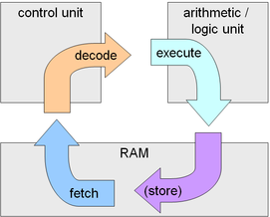
The Fetch – Execute Cycle

Slide 18
The fetch-decode-execute cycle: Fetch
The program counter contains the location of the instruction that is to be executed next. This address is copied to the MAR.
The instruction is fetched from the memory and copied to the MDR first.
Then, contents of the MDR are copied to the CIR (Current Instruction Register).
The value in a program counter is incremented by 1 and, hence, the instruction in the next memory location is processed.

Slide 19
The fetch-decode-execute cycle: Decode and execute
Decode
The instructions in the CIR are decoded so that it can be executed.
Execute
The processor sends appropriate control signals to the memory unit and input-output devices in the computer system, according to the decoded instruction.

Slide 20
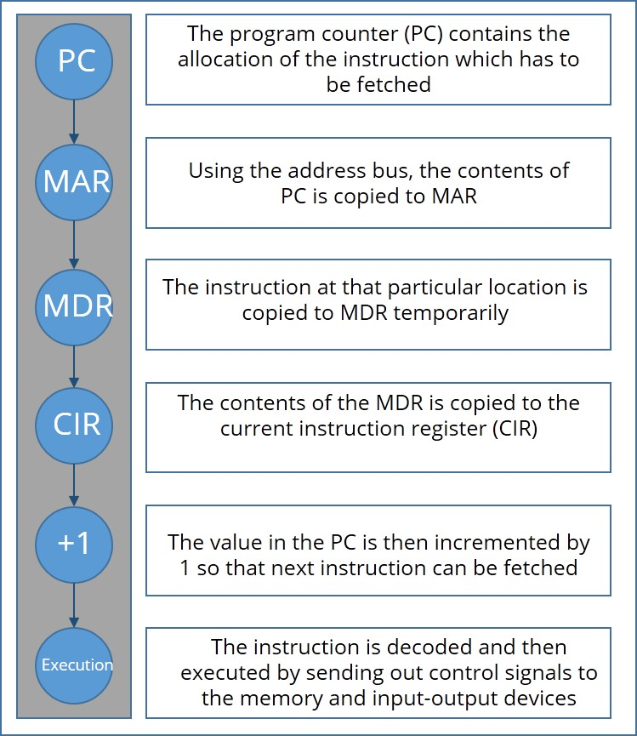
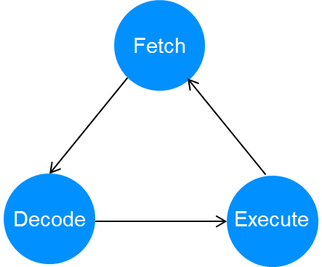
Registers involved in the Fetch –Decode – Execute Cycle

Slide 21
Von Neumann Architecture -> The Bus
A bus is a communication pathway that allows data and instructions to travel between different components in a computer. Think of it as a collection of wires that allow data and instructions to move from memory to the CPU and back.
There are many buses on the motherboard. The speed of a bus is measured in megahertz (MHz). The faster the bus, the faster data is communicated. The speed of the motherboard is defined by the bus speed.
Buses are limited by their width in bits. They are usually 8, 16 or 32-bits wide. This tells us how many bits can be sent by the bus at any one time, eg a 32-bit bus can send 32 bits at once.

Slide 22
von Neumann architecture The Buses
Memory
unit
Processor
Input &
Output
Legend
Address bus
I/O Devices
Data bus
Control bus

Slide 23
Buses
Type of bus | Function | Direction of bus
Address bus | Transmits the address between the processor and the memory | Unidirectional: From the processor to the memory, and input-output devices
Data bus | Sends data between the processor, memory, and input-output devices | Bi-directional
Control bus | Signals sent by the processor to control the memory and peripheral devices | Unidirectional: From the processor to the memory, and input-output devices

Slide 24
Let’s review some concepts
Buses
The connection between the processor, memory, and input-output devices.
Processor
The processor contains ALU (Arithmetic and Logic unit) and Control Unit (CU).
CIR (Current Instruction register)
The CIR contains the current instruction carried out by the processor
PC (Program Counter)
The PC contains the location of the instruction that is to be executed next.
Accumulator
Accumulator (ACC) is the register that stores the results of arithmetic and logical operations performed by the processor.

Slide 25
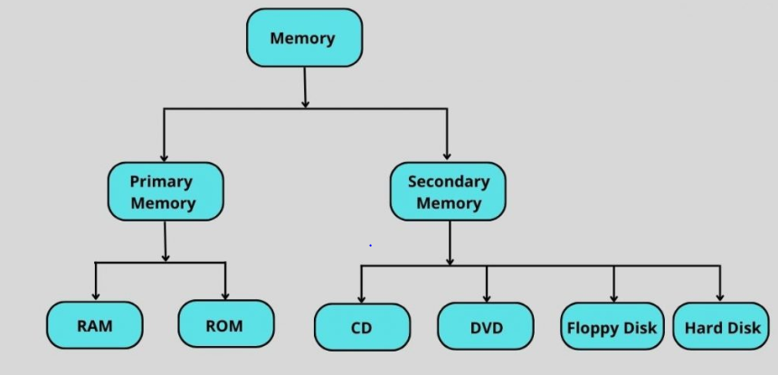
Von Neumann Architecture - Memory
Early computers could not store programs internally. Programs had to be stored externally on punch cards, magnetic tapes or floppy disks.
Modern computers store programs internally in memory.

Slide 26
Primary Memory - RAM
RAM is PRIMARY Memory
Random Access Memory (RAM) is known as volatile memory. If the computer loses power, the data in RAM is lost. RAM is fast compared to other memory that is not volatile.
RAM holds the data and instructions of the program that is currently being executed by the CPU.
RAM is not where files are stored for long-term use, e.g photos on your computer. They are stored in secondary memory.

Slide 27
Primary Memory - ROM
ROM read only memory is non-volatile. Its contents remain stored whether the computer is powered on or not. A typical use of ROM is to store the computer’s BIOS (Basic input/output system) which is the software responsible for booting up the system. When computer is turned on, BIOS performs the necessary checks and then hands control over to the operating system

Slide 28
Memory
Memory used to store information for immediate use by the CPU is also referred to as main memory or primary storage. RAM and ROM are both types of primary storage
How computer memory works
BBC Bitesize Revision - CPU & Memory

Slide 29
System Archtecture - CPU
Cache
Cache is a small amount of high-speed random access memory (RAM) built directly within the processor. It is used to temporarily hold data and instructions that the processor is likely to reuse. This allows for faster processing, as the processor does not have to wait for the data and instructions to be fetched from the RAM.

Slide 30
Factors Determining the Speed of the CPU
Even though today's processors are tremendously fast, their performance can be affected by a number of factors including:
clock speed
Number of cores
- Cache size
- RAM

Slide 31
Factors Determining the Speed of the CPU
Number of cores. A processing unit within a CPU is known as a core. Each core is capable of fetching, decoding and executing its own instructions. The more cores a CPU has, the greater the number of instructions it can process in a given space of time.

Slide 32
Factors Determining the Speed of the CPU
Clock speed. Clock speed is the number of pulses the CPU’s clock generates per second. It is measured in hertz. The more pulses per second, the more fetch-decode-execute cycles that can be performed and the more instructions that are processed in a given space of time.

Slide 33
Factors Determining the Speed of the CPU
Cache. A cache is a fast, relatively small capacity set of locations that is built directly within the processor. Cache is used to store the instructions and data that the processor is most likely to need and reuse. The bigger its cache, the less time a processor has to wait for instructions to be fetched. •

Slide 34
Factors Determining the Speed of the CPU
RAM. This is the short-term memory of the computer that holds all of the programs and data currently being ran by the computer. Having more memory means that the data and instructions that need to be processed will not have to be fetched from secondary storage (which is a much slower process).
Temperature. If CPU gets too hot performance will decrease.

Slide 35
Factors affecting the speed of a CPU
https://www.youtube.com/watch?v=eS1rEJZKr4U

Slide 36
Von Neumann Architecture -> Secondary Storage
Secondary devices are used to store data persistently. They store information regardless of whether the computer is turned on or not. It is non-volatile memory, unlike RAM that is volatile.

Slide 37
Differences between Primary and Secondary storage
Primary storage stores information for immediate use by the CPU while secondary storage stores data that can be used at any time.
Primary storage stores data temporarily (apart from ROM), whereas secondary storage stores data persistently
Primary storage is faster than secondary storage

Slide 38
Differences between Primary and Secondary storage
Primary storage is more expensive than secondary storage per unit, such as megabyte(MB) or gigabyte (GB).
Primary storage is smaller ( less capacity)

Slide 39
Secondary storage
A typical modern personal computer can store up to several terabytes (TB). RAM is in the order of several or several dozen gigabytes (GB)
Secondary storage are normally hard drives. There are 2 types of hard drives magnetic and solid state disk (SSD). Magnetic hard drives are more common.
Magnetic hard disks contain a magnetic platter that turns at a very high speed. A head moves across the spinning platter and reads information

Slide 40
Secondary storage
Solid State Disks (SSD) is becoming more widespread. These are faster and more durable than magnetic disks because they have no moving parts. Most SSD are based on flash memory. Flash memory is what USB memory stick are based on.
SSD are expensive but the price is falling

Slide 41
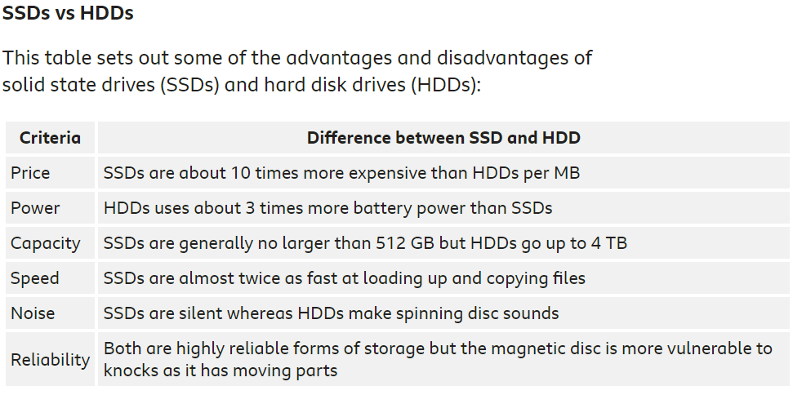

Slide 42
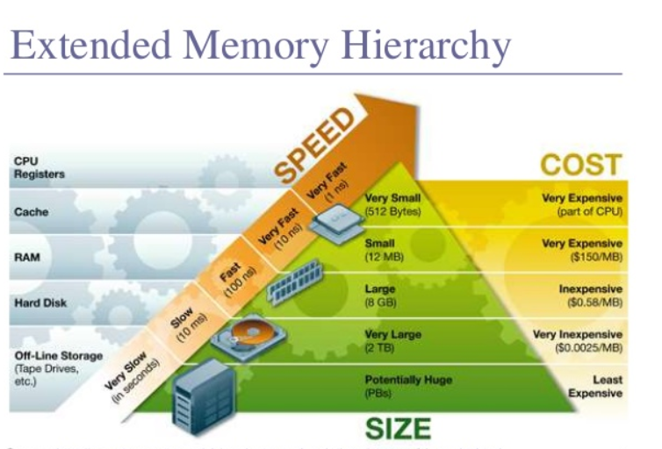
Speed & Cost of Memory

Slide 43
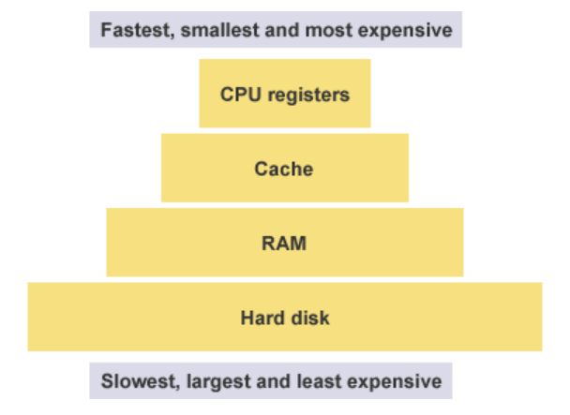
Memory Overview
The closer a memory type is to the CPU, the quicker the CPU can access the instructions and execute them. However, the closer it is to the CPU the smaller and more expensive it is. Each type of memory is limited by their speed, size, cost and position in relation to the CPU.

Slide 44
The Motherboard
BBC Bitesize Revision Motherboard
The motherboard is a circuit board that devices are physically mounted on.
It connects the CPU to the memory and all the other hardware. The CPU sits on the motherboard
Motherboard’s typically include: CPU, main memory, hard drive and many other components such as I/O devices.
When you plug in a USB device into a computer, you are physically connecting to the mother board

Slide 45
Operating Systems
An operating system (or 'OS') controls the general operation of a computer, and provides an easy way for us to interact with computers and run applications.
The OS runs runs all the time in the background
Every computer has an OS. They could not run without it.

Slide 46
Operating Systems
There are a few common operating systems available:
Mac OS X - operating system for Macs
Linux, Ubuntu, Unix – based on Unix
Windows
Android (based on Linux)
Apple iOS

Slide 47
Functions of the Operating Systems
The operating system performs several key functions:
interface - provides a user interface so it is easy to interact with the computer, known as “user interface”
manages the CPU - runs applications and executes and cancels processes
multi-tasks - allows multiple applications to run at the same time
Manages memory - transfers programs into and out of memory, allocates free space between programs, and keeps track of memory usage

Slide 48
Functions of the Operating Systems
The operating system performs several key functions:
5. Manages peripherals - opens, closes and writes to peripheral devices such as storage attached to the computer
6. organises - creates a file system to organise files and directories and manages it
7. security - provides security through user accounts and passwords
8. utilities - provides tools for managing and organising hardware

Slide 49
Operating Systems Functions – User Interface
User interface
A user interface is the means by which the user provides input to a computer and the computer conveys output to the user. Specifically, it is the point of interaction between a user and a computer through the use of input / output devices.
The UI is either graphical or text-based.
Graphical user interface (GUI)
The OS on most computers and smartphones provides an environment with tiles, icons and/or menus. This type of interface is called the graphical user interface (GUI) because the user interacts with images through a mouse, keyboard or touchscreen.

Slide 50
Operating Systems – User Interface
Command line interface (CLI)
An OS also provides a method of interaction that is non-graphical, called the command line interface (CLI). This is a text-only service with feedback from the OS appearing in text. Using a CLI requires knowledge of the commands available on a particular machine.
Advantages of using the command line include:
a faster way to get tasks done
it is more flexible than a GUI
it uses less memory
Some games, such as Minecraft, also make use of a command line tool which allows the user to bypass the main interface and alter the game’s mechanics or environment.

Slide 51
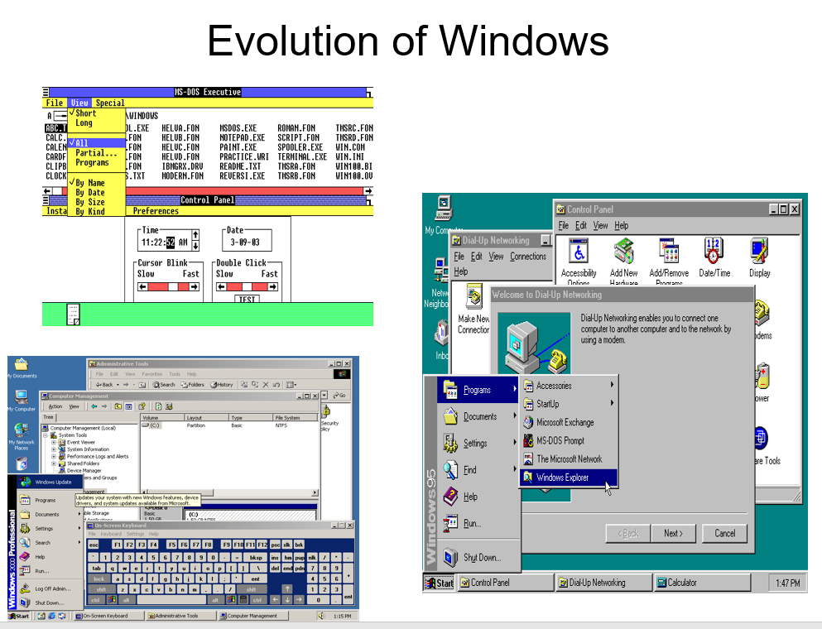
Operating Systems – User Interface

Slide 52
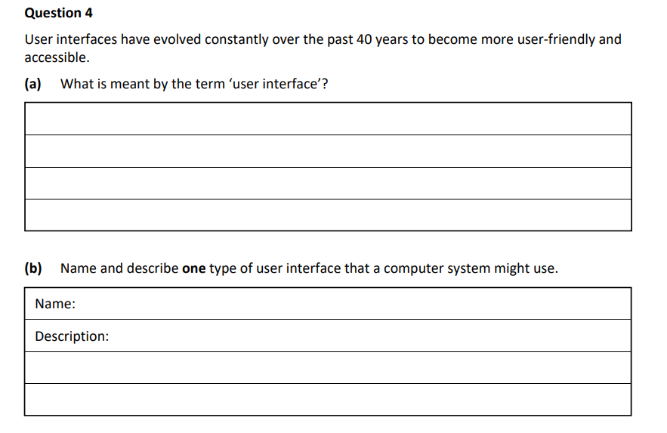
2023 LC Higher Level Q4

